Slide 1
IBM AICTE
PROJECT
LearnMate AI
PRESENTED BY:
STUDENT NAME:M.SANTHOSH
COLLEGE NAME:AVS ENGG COLLEGE
DEPT: COMPUTER SCIENCE ENGG

Slide 2

OUTLINE:
1.ProblemStatement
2.​Technologyused
3.Wowfactor
​4.Endusers
​5.Result
​6.Conclusion
​7.Git-hubLink
​8.Futurescope
​9.IBMCertiﬁcations

Slide 3

PROBLEM STATEMENT:
Many students feel lost in a maze of online courses, unsure which path fits their goals. Without tailored guidance, their learning becomes scattered and inefficient. LearnMate solves this by using Agentic AI to build adaptive, interest-based course roadmaps—powered by IBM Cloud Lite and Granite—to guide students confidently and personally.
PROPOSED SOLUTION:
LearnMate is an Agentic AI coach that interacts with students, understands their interests and skill levels, and builds dynamic, personalized course roadmaps. Powered by IBM Cloud Lite and Granite, it adapts over time to guide learners toward meaningful, goal-aligned progress.

Slide 4

TECHNOLOGY USED:
IBM Cloud Lite
IBM Granite Models.
Watsonx.AI
Natural Language Processing (NLP)

Slide 5

IBM CLOUD SERVICES USED:
IBM Cloud Watsonx AI Studio
IBM Cloud Watsonx AI runtime
IBM Cloud Agent Lab
IBM Granite foundation mode

Slide 6

WOW FACTORS:
LearnMate runs on IBM Cloud Lite, combining Watsonx and Granite LLMs to deliver intelligent, adaptive student guidance—right from the browser. There's no setup required; users just access and engage. The system is responsive, secure, and designed for scale, backed by enterprise-grade IBM infrastructure. It's not just hosted—it’s built for real-world impact.

Slide 7

END USERS:
College Students
Freshers
High School Students
Working Professionals

Slide 8

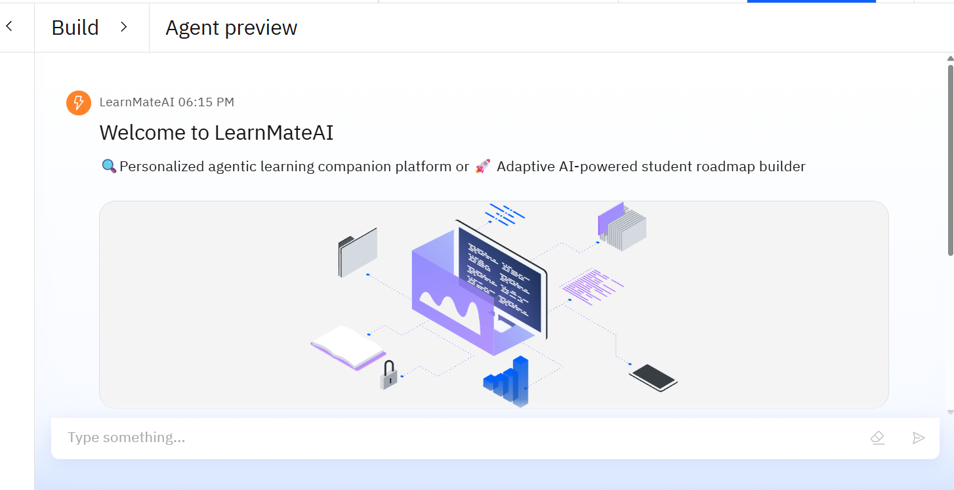
RESULTS:

Slide 9
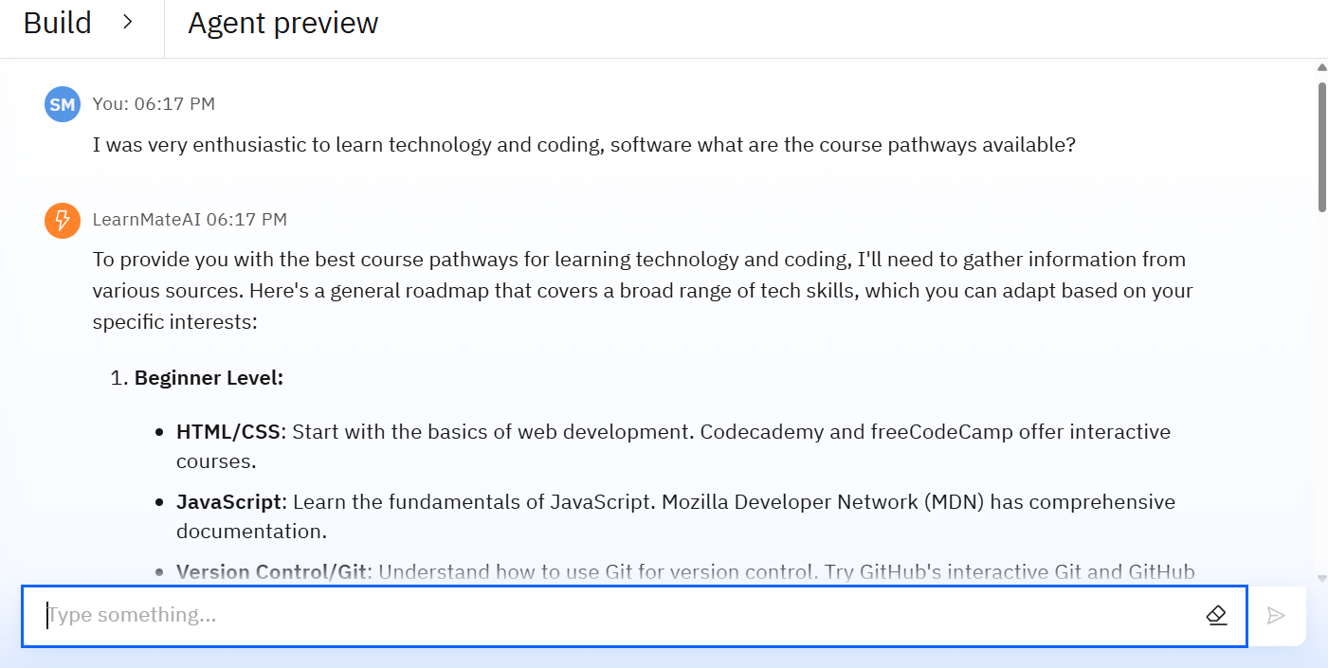
RESULTS:

Slide 10
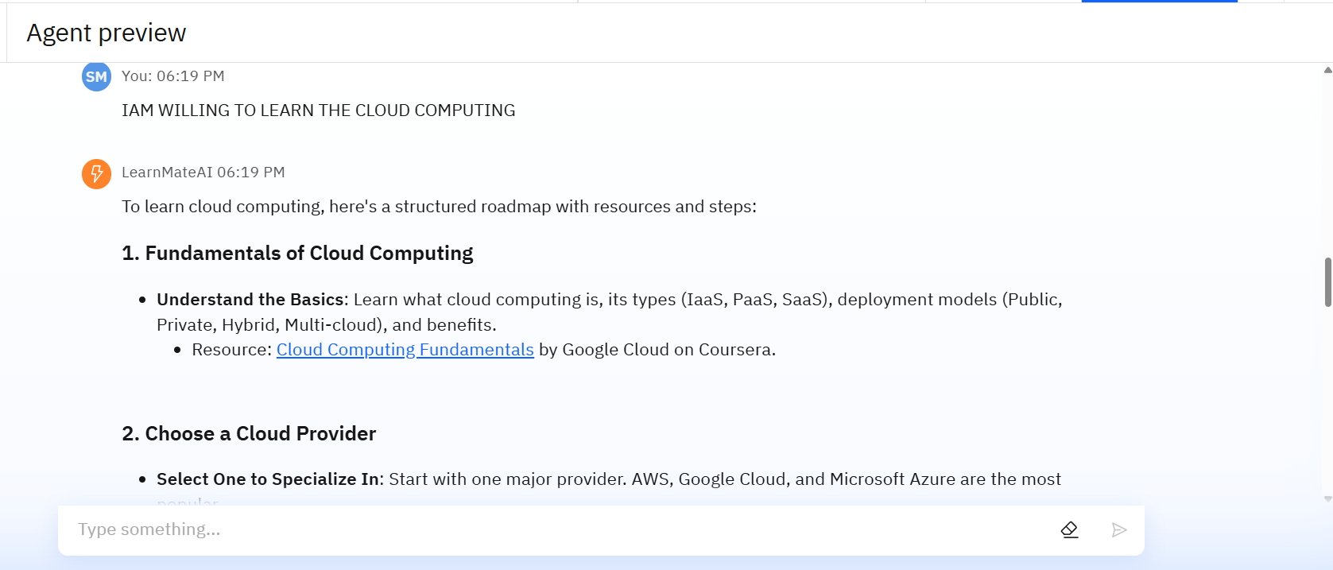
RESULTS:

Slide 11
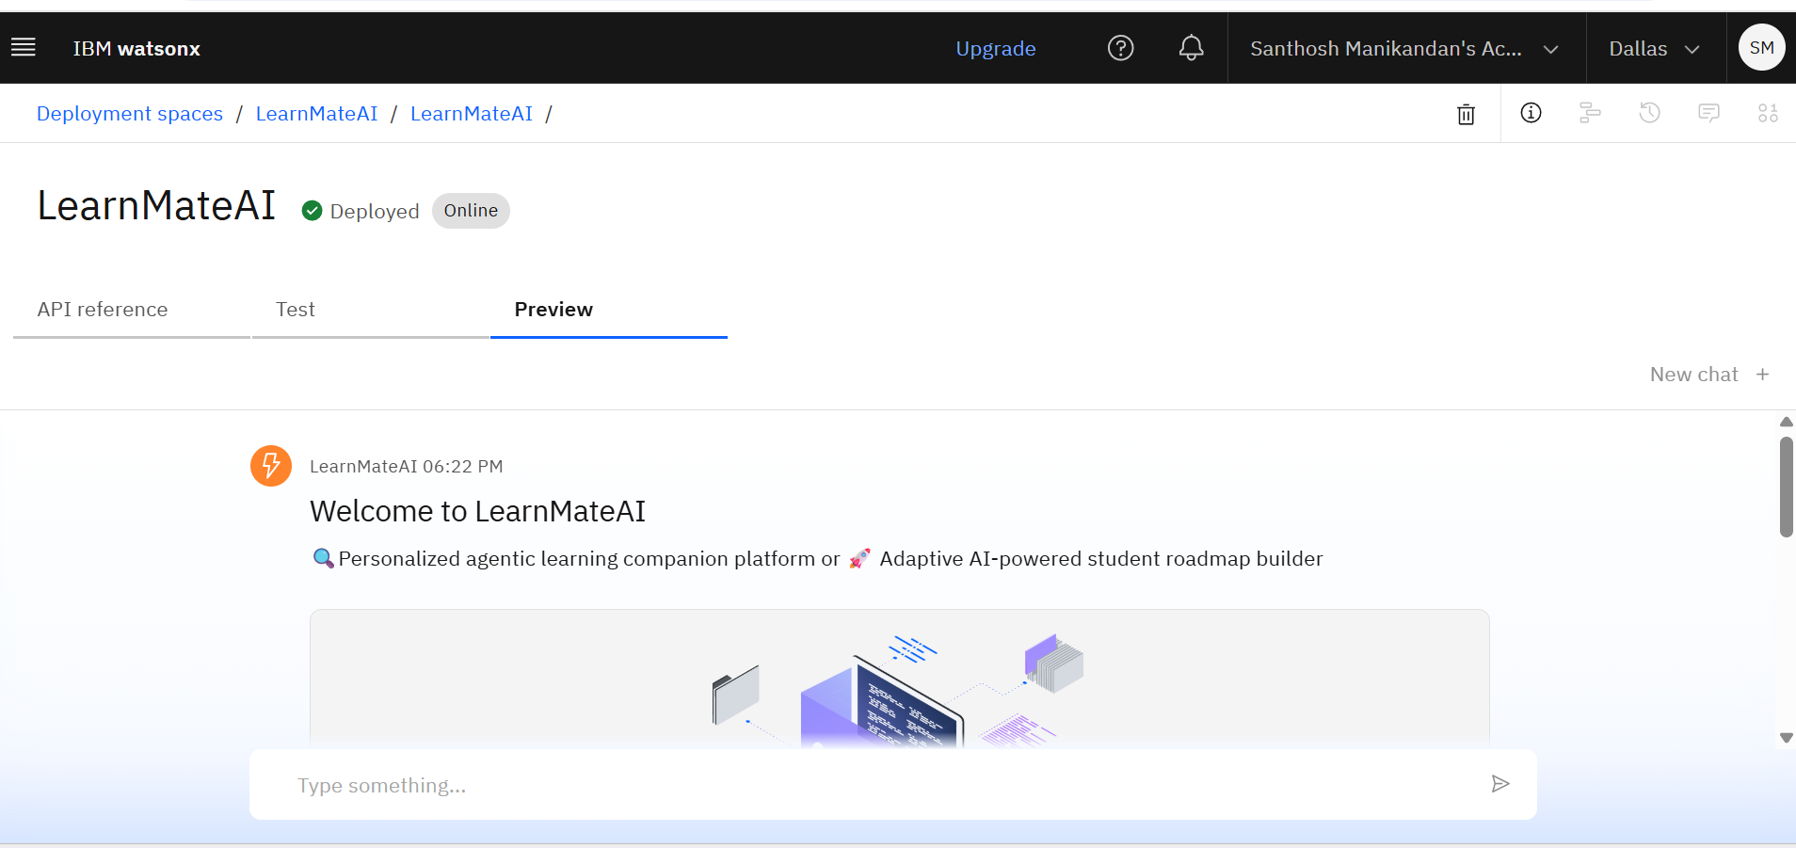
RESULTS:
DEPLOYMENT SPACE:

Slide 12
CONCLUSION:
LearnMate bridges the gap between overwhelming course options and meaningful student guidance using Agentic AI.
Powered by IBM Cloud Lite, Watsonx, and Granite LLMs, it delivers scalable, secure, and intelligent support for learners.
Designed for adaptability, the platform evolves with user progress and personal goals to ensure lasting relevance.
LearnMate isn’t just a tech solution—it’s a learning companion, reshaping how students discover, grow, and succeed.

Slide 13

GITHUB LINK:
https://github.com/Msanthosh-hub/LearnMate_AI.git

Slide 14
FUTURE SCOPE:
Scalability across disciplines: LearnMate can be expanded to guide students in various fields, from engineering to humanities.
Multilingual and inclusive access: Integrating language support can make guidance available to learners in diverse regions.
AI-powered personalization: Future updates could offer real-time adaptive feedback tailored to each student’s learning journey.
Career-integrated pathways: The platform can evolve to map skills to jobs, internships, and certifications, boosting long-term relevance.

Slide 15

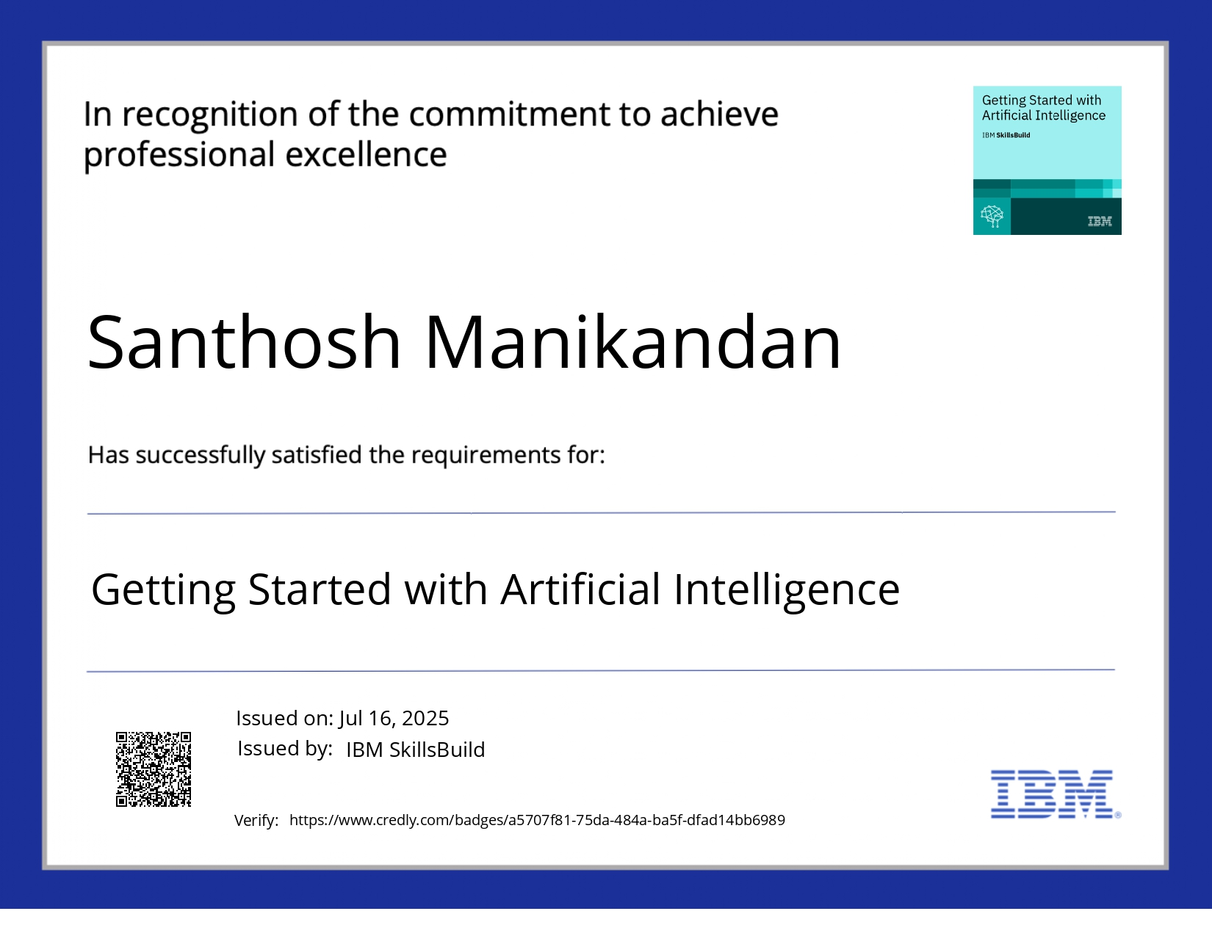
IBM CERTIFICATION:

Slide 16



THANK YOU

